Slide 1
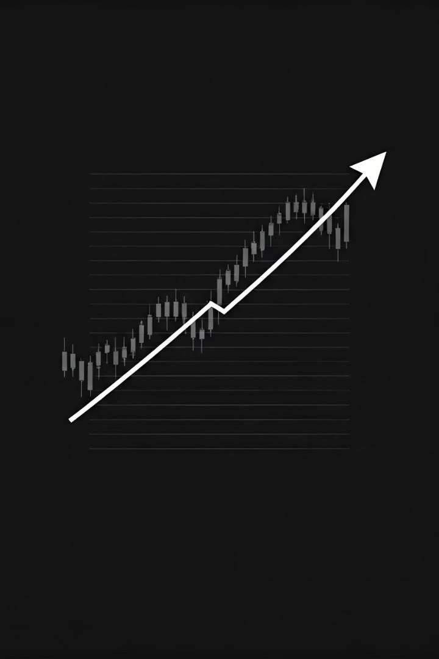
Real-Time data Analysis System
Python-Powered Stock Market Dashboard
Notes:
1

Slide 2
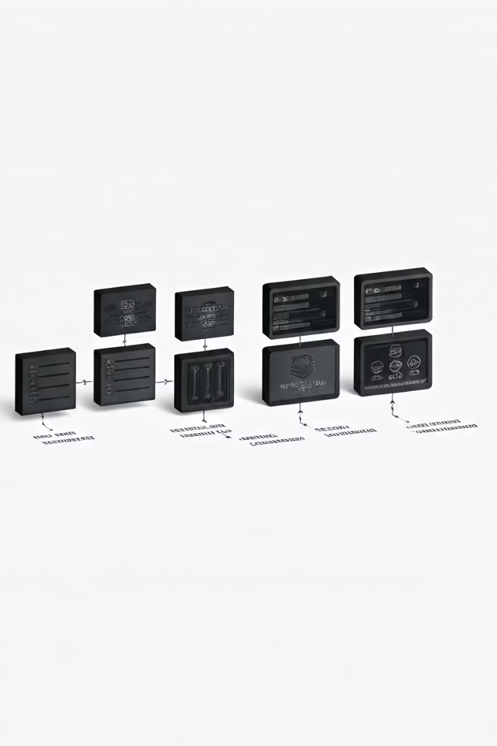

System Overview
The purpose of this system is to provide real-time monitoring and analysis of stock market data. The core components include data acquisition from the Alpha Vantage API, a statistical analysis engine, and an interactive web dashboard.
Notes:
2

Slide 3
Technical Architecture
Backend
Key Libraries
The backend is built using Python with multi-threading capabilities. The data flow follows the sequence: API → Queue → Analyzer → Web Server → Browser.
Requests, NumPy, Threading
HTTP.Server, Socketserver
Plotly.js (frontend)
Notes:
3

Slide 4

Data Pipeline
1
Data Source
2
Processing
The system pulls data from the Alpha Vantage API, with a fallback mechanism in place.
The data is subjected to statistical analysis and anomaly detection.
3
Storage
4
Tracked Stocks
In-memory data structures with thread synchronization are used for storage.
The system currently tracks the following stocks: AAPL, GOOGL, MSFT, AMZN, META.
Notes:
4

Slide 5




Core Features
Real-time Data Updates
Multi-Stock Tracking
Statistical Analysis
Responsive Dashboard
Users can track and compare multiple stocks simultaneously.
The system provides real-time calculations of mean and standard deviation.
The web-based dashboard adapts to various device sizes and resolutions.
The system updates stock data at 15-second intervals.
Notes:
5

Slide 6
Dashboard Overview
Interactive Charts
Real-time Statistics
Price trends (time series)
Current prices and volumes
Volume comparison (logarithmic scale)
Statistical indicators
Anomaly warnings
Notes:
6

Slide 7

Data Analysis Techniques
1
Statistical Methods
Rolling averages and standard deviations
Z-score anomaly detection (threshold: 2.0)
2
Resilience Features
API fallback with realistic simulated data
Error handling and logging
Notes:
7

Slide 8
Technical Highlights
Multi-threaded Architecture
Web Technologies
Producer-consumer pattern with thread-safe queue
Python's built-in HTTP server
Client-side JavaScript for dynamic updates
Plotly.js for interactive visualization
Concurrent data processing and web serving
Notes:
8

Slide 9
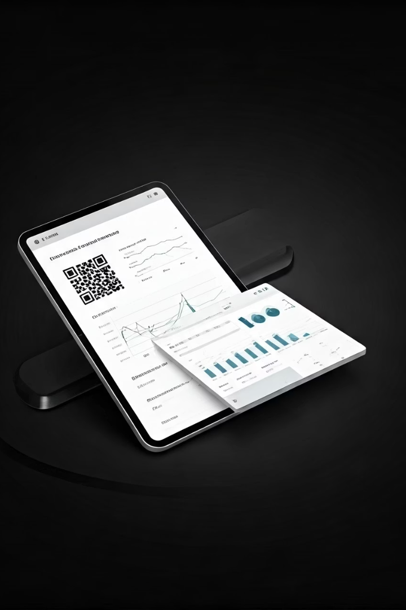
Live Demo
You can access the live dashboard at http://localhost:8051. The main features to observe include real-time price and volume updates, statistical analysis cards, and anomaly indicators.
Notes:
9

